Slide 1
Chapter 2
0
Motion in One Dimension

Slide 2
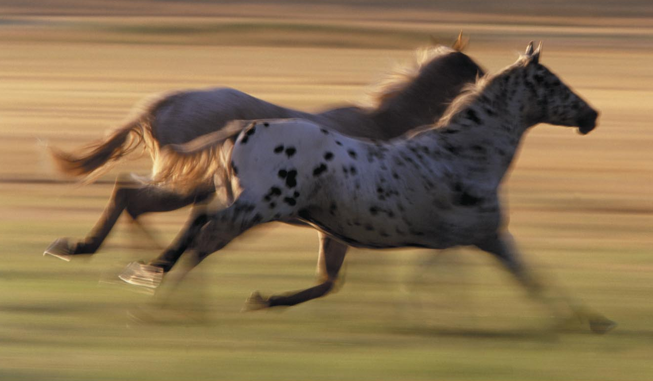
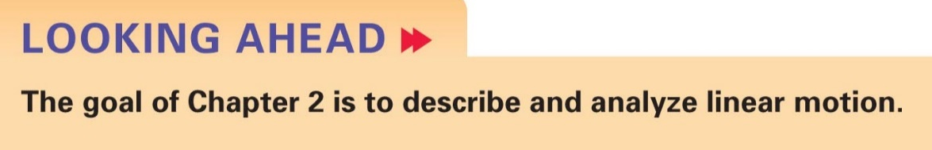

2 Motion in One Dimension
Slide 2-2

Slide 3


If you are swimming upstream, at what speed does your friend on the shore see you moving?
Your velocity
Water velocity
$$\vec{s}=−4\frac{\text{m}}{\text{s}}$$
$$\vec{w}=2\frac{\text{m}}{\text{s}}$$

Slide 4
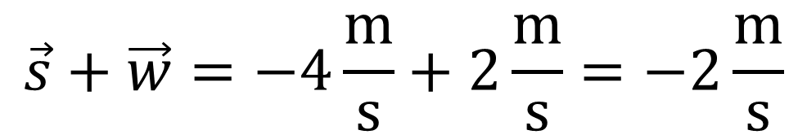
If you are swimming upstream, at what speed does your friend on the shore see you moving?
Velocity relative to the shore
Water velocity
Swimming velocity
$$\vec{s}+\vec{w}=−4\frac{\text{m}}{\text{s}}+2\frac{\text{m}}{\text{s}}=−2\frac{\text{m}}{\text{s}}$$

Slide 5
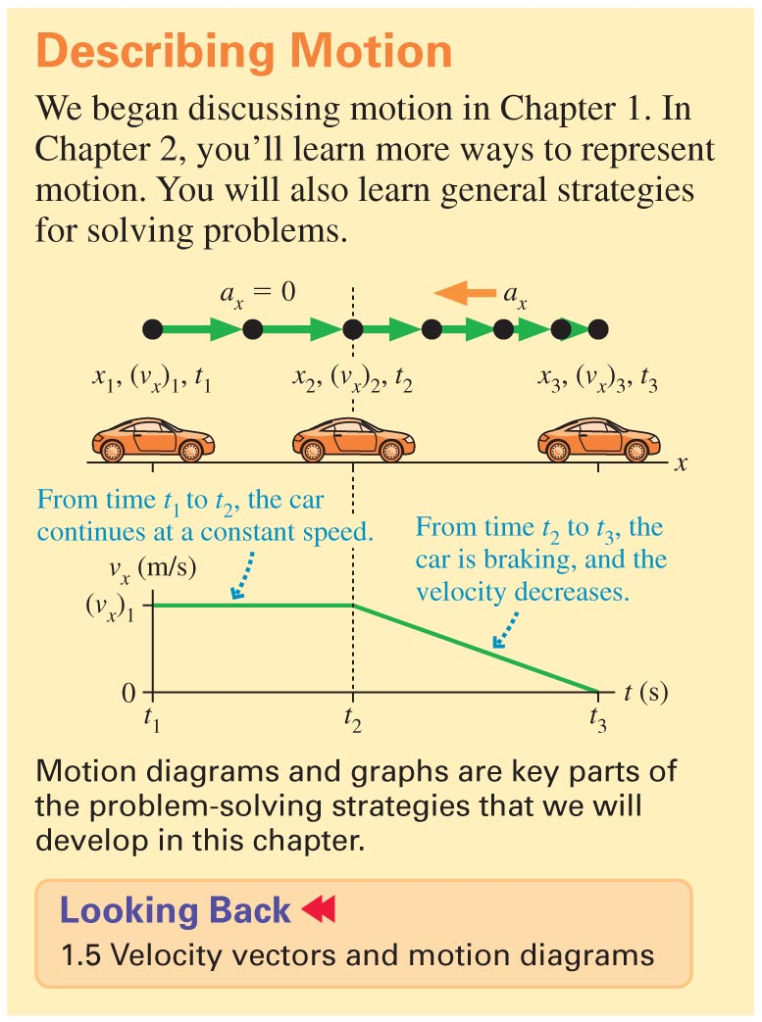
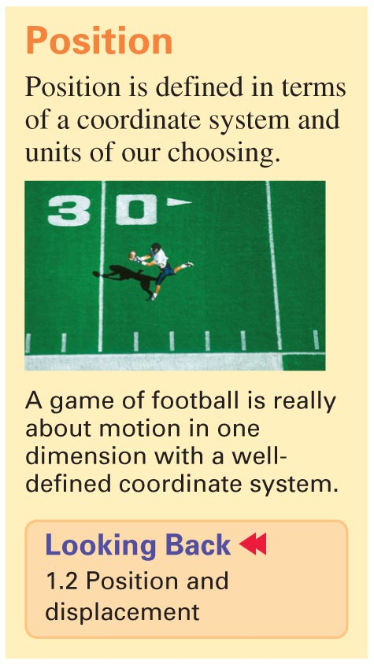
Slide 2-3

Slide 6
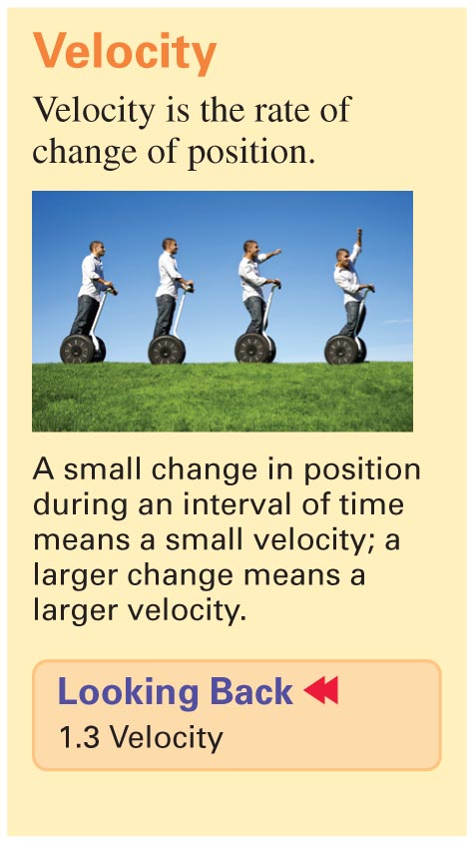
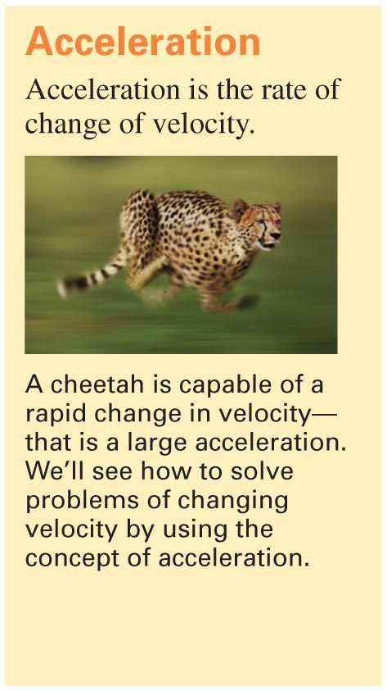
Slide 2-4

Slide 7
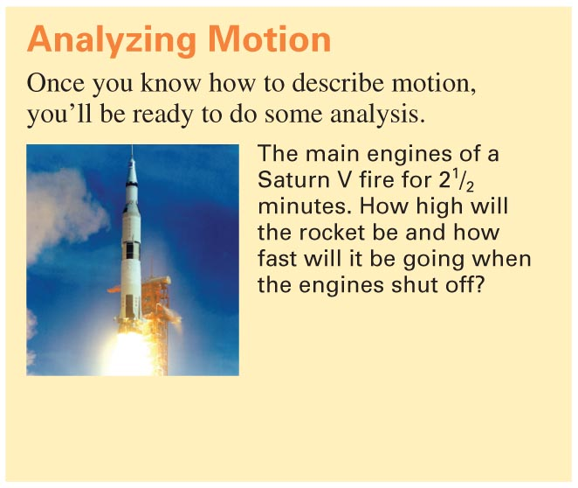
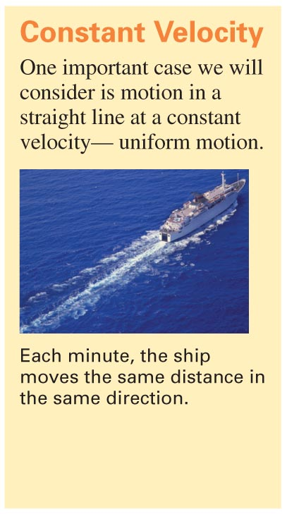
Slide 2-5

Slide 8
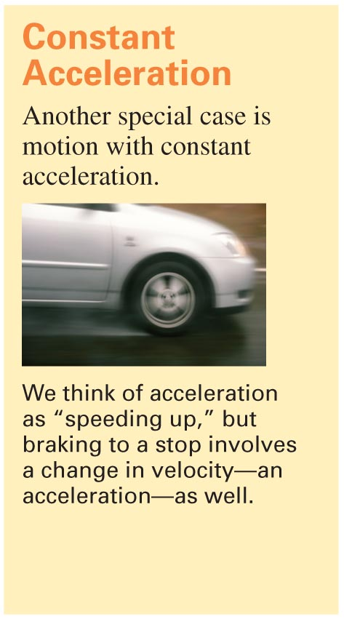
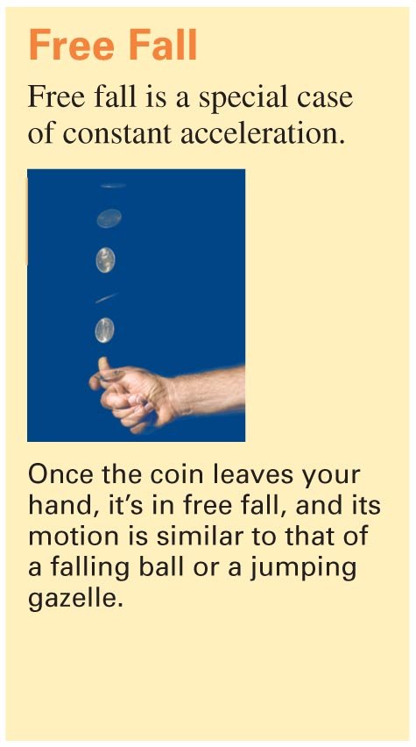
Slide 2-6

Slide 9

Reading Quiz
A 1-pound ball and a 100-pound ball are dropped from a height of 10 feet at the same time. In the absence of air resistance
the 1-pound ball hits the ground first.
the 100-pound ball hits the ground first.
the two balls hit the ground at the same time.
D. There’s not enough information to determine which ball wins the race.
Slide 2-11
Notes:
Answer: C

Slide 10
Answer
A 1-pound ball and a 100-pound ball are dropped from a height of 10 feet at the same time. In the absence of air resistance
the 1-pound ball hits the ground first.
the 100-pound ball hits the ground first.
the two balls hit the ground at the same time.
D. There’s not enough information to determine which ball wins the race.
Slide 2-12
Notes:
Answer: C

Slide 11
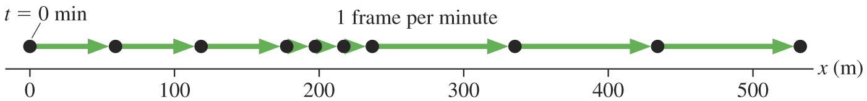
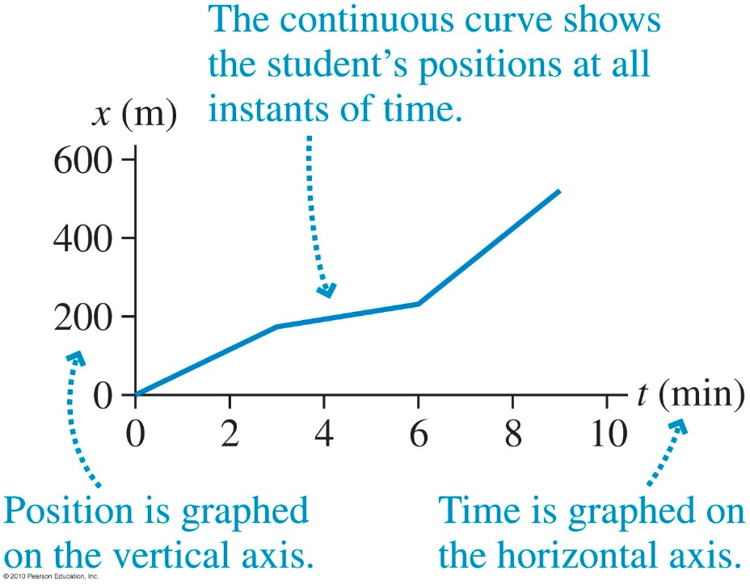
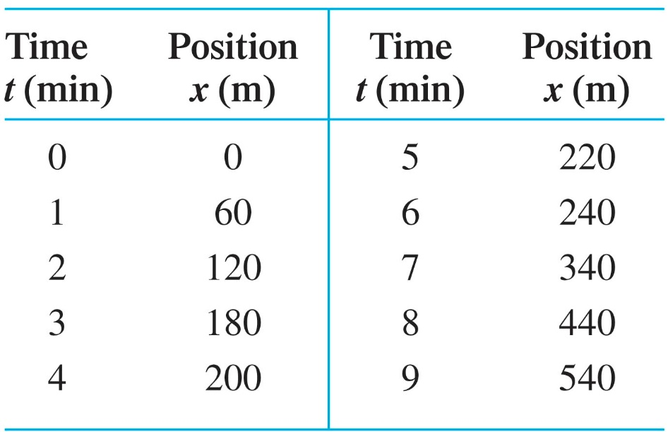
Representations
Motion diagram (student walking to school)
Table of data
Graph
Slide 2-13

Slide 12
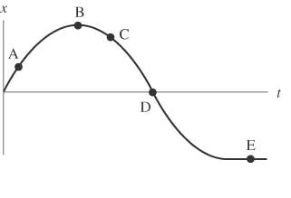
Example Problem
A car moves along a straight stretch of road. The graph below shows the car’s position as a function of time.
At what point (or points) do the following conditions apply?
The displacement is zero.
The speed is zero.
The speed is increasing.
The speed is decreasing.
Discuss now
Slide 2-14

Slide 13
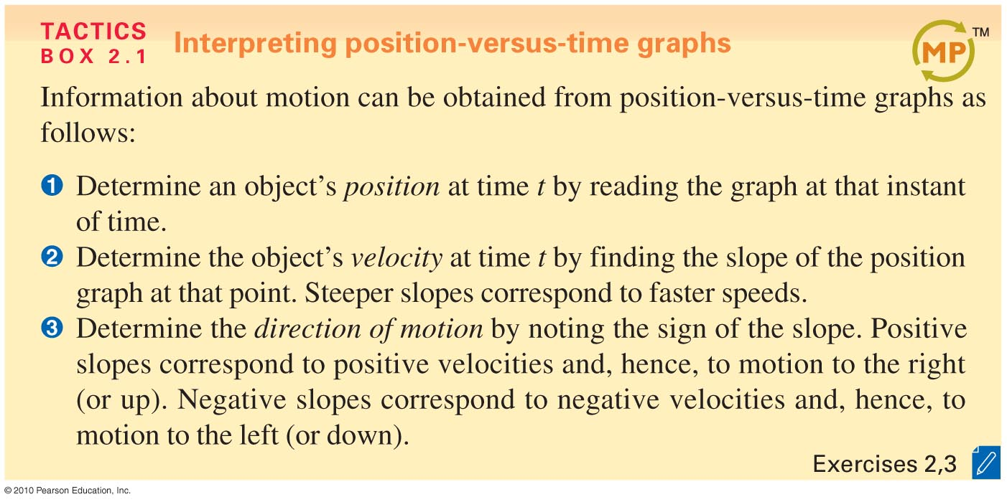
Slide 2-16

Slide 14
Representing Position
Position-vs-Time Graph(x vs. t)
x(meters)
5
5
10
t(time)

Slide 15
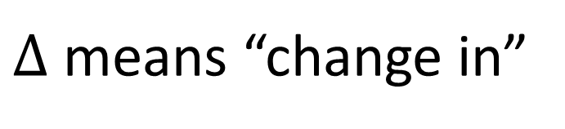
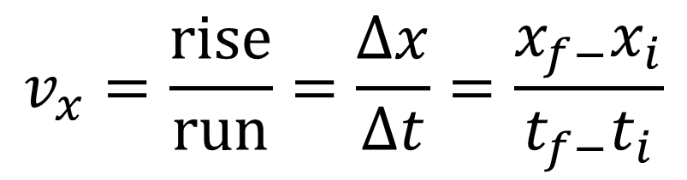
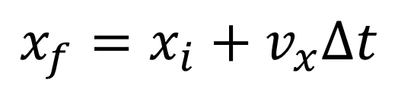
Uniform motion
motion in a straight line at a constant speed
$$v_{x}=\frac{\text{rise}}{\text{run}}=\frac{∆x}{∆t}=\frac{x_{f−}x_{i}}{t_{f−}t_{i}}$$
$$x_{f}=x_{i}+v_{x}∆t$$
$∆$ means “change in”

Slide 16
What was the particle doing around 9 seconds?
x(meters)
Position-vs-Time Graph(x vs. t)
5
5
10
t(time)
Moving forward at a constant speed
Standing still
Moving backward
Accelerating back ward

Slide 17
Position to Velocity
Velocity-vs-Time Graph(v vs. t)
v(meters/second)
5
10
Position
t(time)

Slide 18
Representing Velocity
Velocity-vs-Time Graph(v vs. t)
v(meters/second)
position
5
Velocity
The steeper these slopes are the more quickly he starts/stops
5
10
t(time)

Slide 19
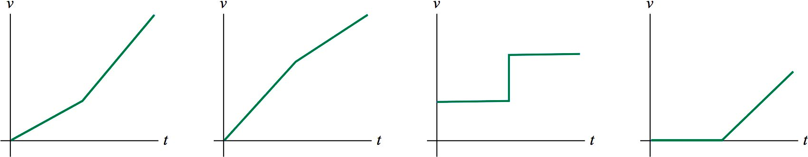
Checking Understanding
Here is a motion diagram of a car moving along a straight stretch of road:
Which of the following velocity-versus-time graphs matches this motion diagram?
A.
B.
C.
D.
Slide 2-17
Notes:
Answer: C

Slide 20
Answer
Here is a motion diagram of a car moving along a straight stretch of road:
Which of the following velocity-versus-time graphs matches this motion diagram?
A.
B.
C.
D.
Slide 2-18
Notes:
Answer: C

Slide 21
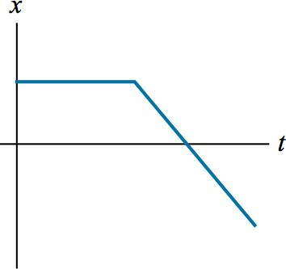
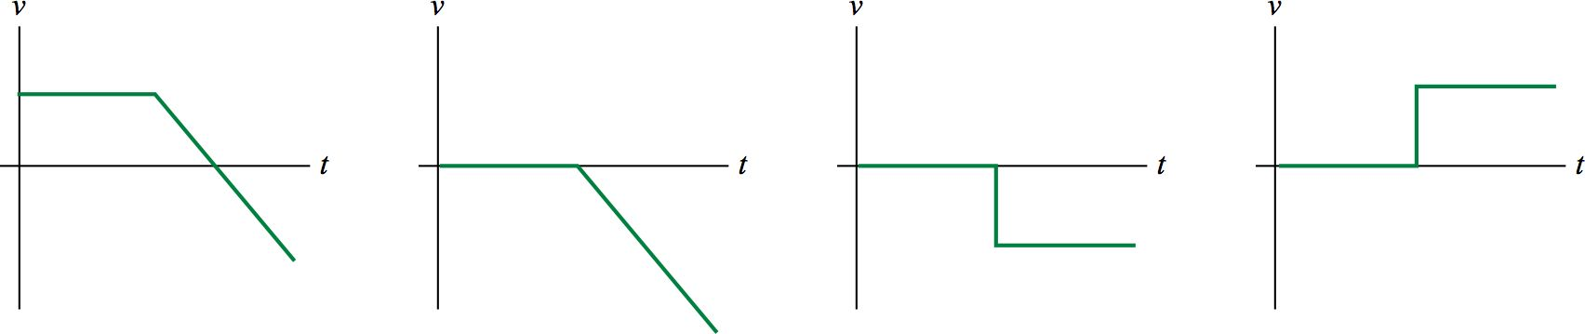
Checking Understanding
A graph of position versus time for a basketball player moving down the court appears like so:
Which of the following velocity graphs matches the above position graph?
A.
B.
C.
D.
Slide 2-19
Notes:
Answer: C

Slide 22
Answer
A graph of position versus time for a basketball player moving down the court appears like so:
Which of the following velocity graphs matches the above position graph?
A.
B.
C.
D.
Slide 2-20
Notes:
Answer: C

Slide 23
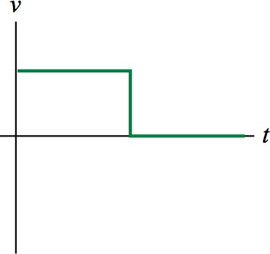
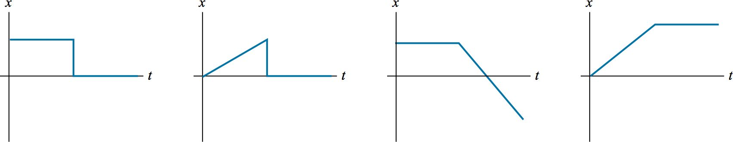
A graph of velocity versus time for a hockey puck shot into a goal appears like so:
Which of the following position graphs matches the above velocity graph?
A.
B.
C.
D.
A
B
C
D

Slide 24
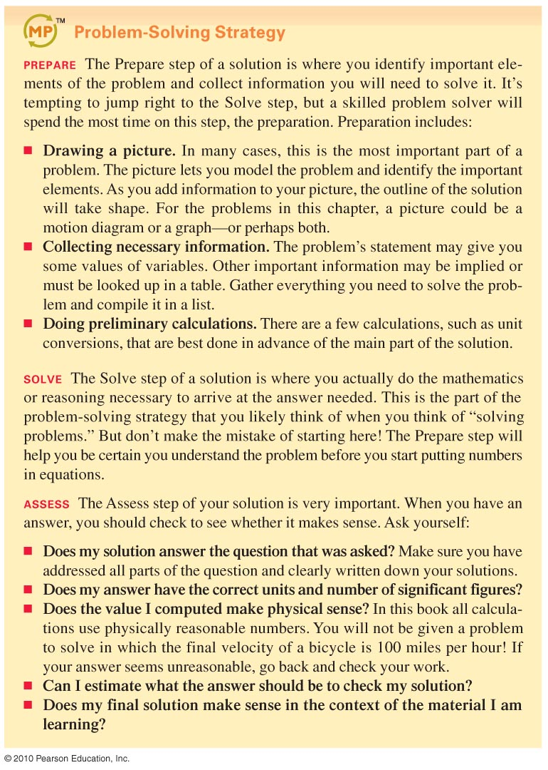
Slide 2-23
Notes:
Answer: D

Slide 25
Slide 2-24
Notes:
Answer: D

Slide 26
What is the area under this curve mean?
v(m/s)
Triangle + Rectangle + Triangle
5
5
10
t(time)

Slide 27
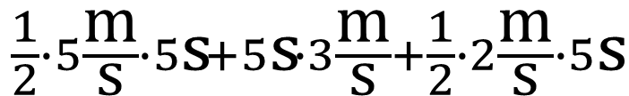
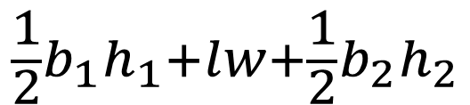
What is the area under this curve mean?
$$\frac{1}{2}b_{1}h_{1}+lw+\frac{1}{2}b_{2}h_{2}$$
$$\frac{1}{2}∙5\frac{\text{m}}{\text{s}}∙5\text{s}+5\text{s}∙3\frac{\text{m}}{\text{s}}+\frac{1}{2}∙2\frac{\text{m}}{\text{s}}∙5\text{s}$$
v(m/s)
What units do we end up with?
5
5
10
t(time)

Slide 28
Reading Quiz
The area under a velocity-versus-time graph of an object is
the object’s speed at that point.
the object’s acceleration at that point.
C. the distance traveled by the object.
D. the displacement of the object.
E. This topic was not covered in this chapter.
Slide 2-9
Notes:
Answer: D

Slide 29
Answer
The area under a velocity-versus-time graph of an object is
the object’s speed at that point.
the object’s acceleration at that point.
C. the distance traveled by the object.
D. the displacement of the object.
E. This topic was not covered in this chapter.
Slide 2-10
Notes:
Answer: D

Slide 30
What is this object’s velocity around 9 seconds?
-2 m/s
4 m/s in the –x direction
2 m/s in the –x direction
-1 m/s
2
1
5
10
t(s)
-1
-2
x(m)

Slide 31




Example Problem
A soccer player is 15 m from her opponent’s goal. She kicks the ball hard; after 0.50 s, it flies past a defender who stands 5 m away, and continues toward the goal. How much time does the goalie have to move into position to block the kick from the moment the ball leaves her foot?
$$5\frac{\text{m}}{\text{s}}$$
15m
5m
Slide 2-25

Slide 32

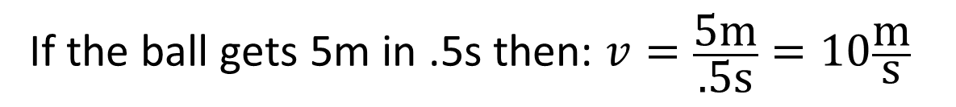
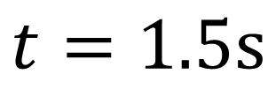
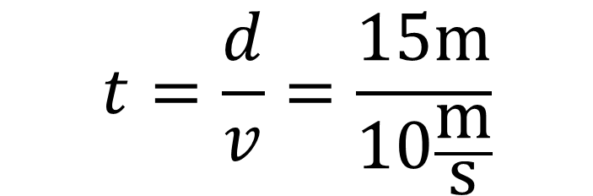

Example Problem
A soccer player is 15 m from her opponent’s goal. She kicks the ball hard; after 0.50 s, it flies past a defender who stands 5 m away, and continues toward the goal. How much time does the goalie have to move into position to block the kick from the moment the ball leaves her foot?
If the ball gets 5m in .5s then: $v=\frac{\text{5}\text{m}}{\text{.5}\text{s}}=10\frac{\text{m}}{\text{s}}$
Find the time by solving $v=\frac{d}{t}$ for $t$
$$t=\frac{d}{v}=\frac{15\text{m}}{10\frac{\text{m}}{\text{s}}}$$
$$t=1.5\text{s}$$
Slide 2-25

Slide 33
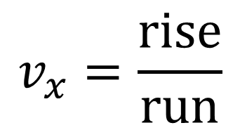
Instantaneous Velocity
Position-vs-Time Graph(v vs. t)
x(m)
t(s)
5
10
The instantaneous velocity at 5 seconds is equal to the slope of the red dashed line
$$v_{x}=\frac{\text{rise}}{\text{run}}$$

Slide 34
Reading Quiz
The slope at a point on a position-versus-time graph of an
object is
the object’s speed at that point.
the object’s average velocity at that point.
the object’s instantaneous velocity at that point.
the object’s acceleration at that point.
the distance traveled by the object to that point.
Slide 2-7
Notes:
Answer: C

Slide 35
Answer
The slope at a point on a position-versus-time graph of an
object is
the object’s speed at that point.
the object’s average velocity at that point.
the object’s instantaneous velocity at that point.
the object’s acceleration at that point.
the distance traveled by the object to that point.
Slide 2-8
Notes:
Answer: C

Slide 36
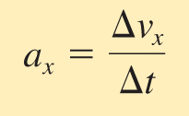
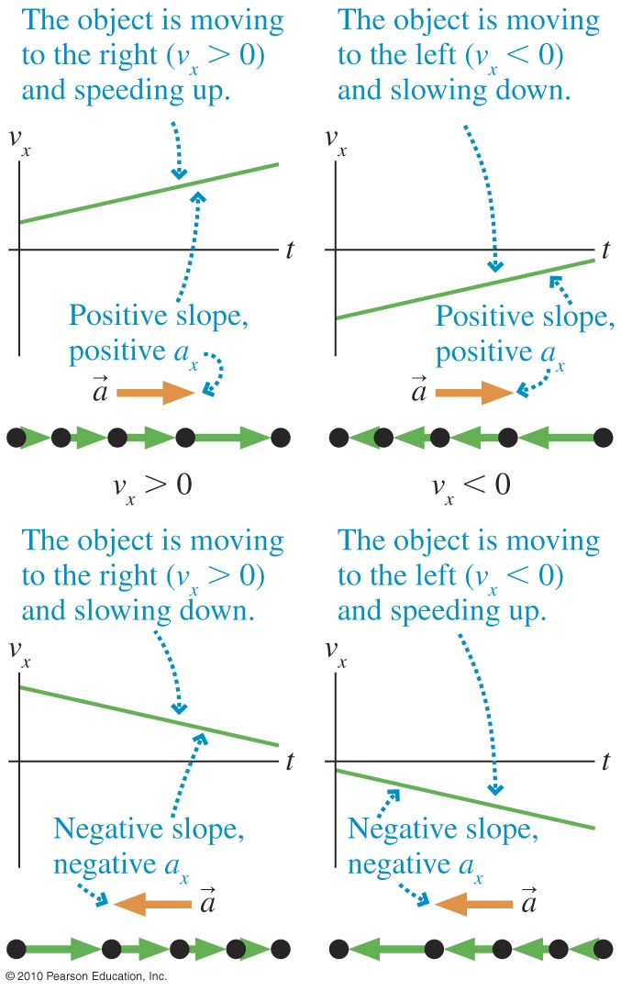
Acceleration
Acceleration is:
The rate of change of velocity
The slope of a velocity-versus-time graph
Slide 2-26

Slide 37
Acceleration
Changing the velocity vector
Ways to change
Lengthen
Change direction
Or both
Time -> each arrowhead is 1 second

Slide 38
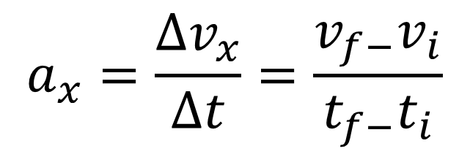
Rate of change of velocity
$$a_{x}=\frac{∆v_{x}}{∆t}=\frac{v_{f−}v_{i}}{t_{f−}t_{i}}$$
The same as the rise over run on v vs. t plot
Acceleration is also a vector

Slide 39
Acceleration
Anything that’s not flat on a v vs. t plot is non-zero acceleration
v(m/s)
Cruise control
t(s)
5
10

Slide 40
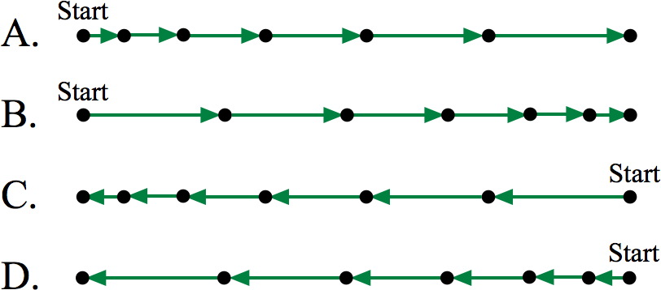
Checking Understanding
These four motion diagrams show the motion of a particle along the x-axis. Rank these motion diagrams by the magnitude of the acceleration. There may be ties.
B > A > D > C
B > A = C > D
A = B = C = D
B = D > A = C
Slide 2-27
Notes:
Answer: C

Slide 41
Answer
These four motion diagrams show the motion of a particle along the x-axis. Rank these motion diagrams by the magnitude of the acceleration. There may be ties.
B > A > D > C
B > A = C > D
A = B = C = D
B = D > A = C
Slide 2-28
Notes:
Answer: C

Slide 42
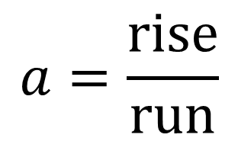

The sign of acceleration
Anything that’s not flat on a v vs. t plot
$v_{x}$(m/s)
t(s)
5
10
$$a=\frac{\text{rise}}{\text{run}}$$
What direction is the acceleration at 4 seconds?

Slide 43
Checking Understanding
These four motion diagrams show the motion of a particle along the x-axis. Which motion diagrams correspond to a positive acceleration? Which motion diagrams correspond to a negative acceleration?
Slide 2-29
Notes:
Answer: D

Slide 44
Answer
These four motion diagrams show the motion of a particle along the x-axis. Which motion diagrams correspond to a positive acceleration? Which motion diagrams correspond to a negative acceleration?
positive
negative
positive
negative
Slide 2-30
Notes:
Answer: D

Slide 45
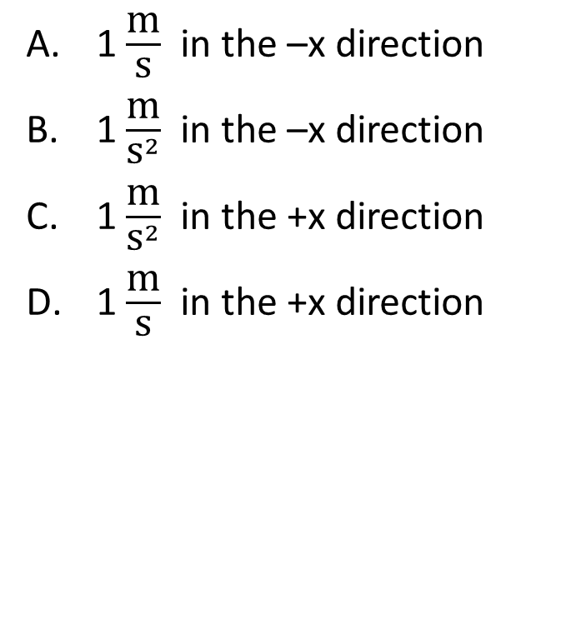

What is the acceleration around 2 seconds?
1 $\frac{\text{m}}{\text{s}}$ in the –x direction
1 $\frac{\text{m}}{{\text{s}}^{2}}$ in the –x direction
1 $\frac{\text{m}}{{\text{s}}^{2}}$ in the +x direction
1 $\frac{\text{m}}{\text{s}}$ in the +x direction
$v_{x}$(m/s)
t(s)
5
10

Slide 46
What is the velocity at 5 seconds?
2 m/s in the +x direction
6 m/s in the +x direction
0 m/s
2 m/s in the –x direction
t(s)
5
10
x(m)

Slide 47
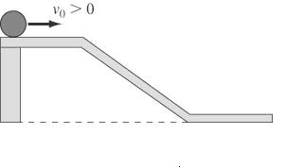
Example Problem
A ball moving to the right traverses the ramp shown below. Sketch a graph of the velocity versus time, and directly below it, using the same scale for the time axis, sketch a graph of the acceleration versus time.
Slide 2-33

Slide 48
Example Problem
A ball moving to the right traverses the ramp shown below. Sketch a graph of the velocity versus time, and directly below it, using the same scale for the time axis, sketch a graph of the acceleration versus time.
t(s)
v(meters per second)
Slide 2-33

Slide 49
Example Problem
A ball moving to the right traverses the ramp shown below. Sketch a graph of the velocity versus time, and directly below it, using the same scale for the time axis, sketch a graph of the acceleration versus time.
t(s)
v(meters per second)
Slide 2-33

Slide 50
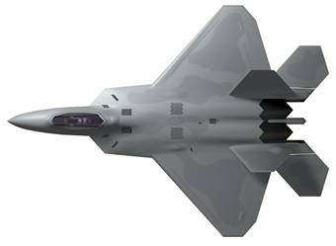


Free Fall
4 s
3 s
2 s
1 s
What’s the package’s velocity 4 seconds after it’s dropped?
$${\left(v_{x}\right)}_{\text{f}}={\left(v_{x}\right)}_{\text{i}}+a_{x}∆t$$

Slide 51
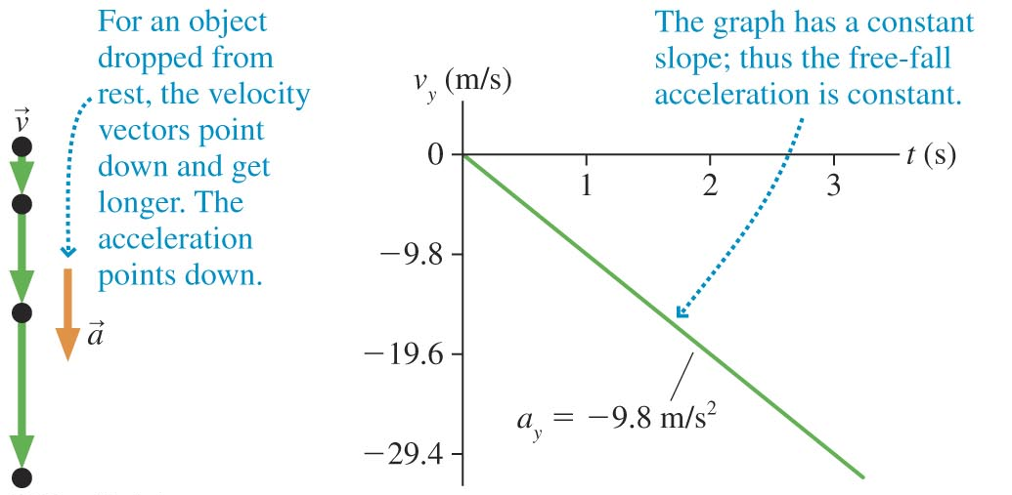
Free Fall
Slide 2-36

Slide 52

Base Jumper’s velocity
v(meters/second)
Mastery question: What is the jumper’s acceleration around 0s?
lands
5
10
t(time)
$$−9.8\frac{\text{m}}{{\text{s}}^{2}}$$
Release’s parachute
Terminal velocity

Slide 53

Base Jumper’s acceleration
a(meters/second squared)
Release’s parachute
lands
Terminal velocity
5
10
t(time)
Corresponding velocity plot
$$−9.8\frac{\text{m}}{{\text{s}}^{2}}$$

Slide 54
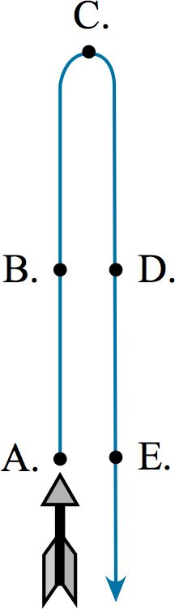
Checking Understanding
An arrow is launched vertically upward. It moves straight up to a maximum height, then falls to the ground. The trajectory of the arrow is noted. Which choice below best represents the arrow’s acceleration at the different points?
A = E > B = D; C = 0
E > D > C > B > A
A = B = C = D = E
A > B > D > E; C = 0
Slide 2-37
Notes:
Answer: C

Slide 55
Answer
An arrow is launched vertically upward. It moves straight up to a maximum height, then falls to the ground. The trajectory of the arrow is noted. Which choice below best represents the arrow’s acceleration at the different points?
A = E > B = D; C = 0
E > D > C > B > A
A = B = C = D = E
A > B > D > E; C = 0
Slide 2-38
Notes:
Answer: C

Slide 56
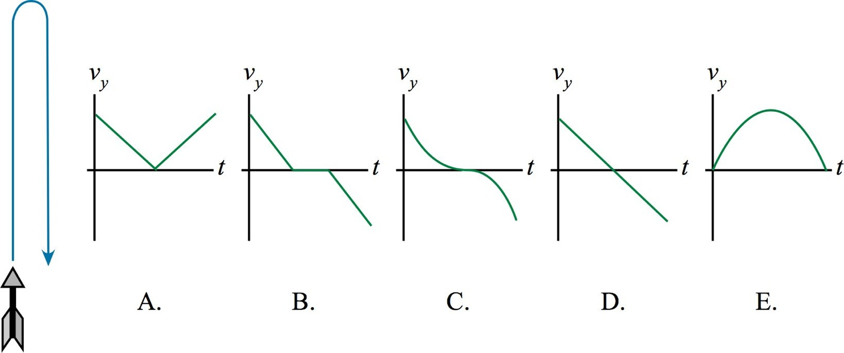
Checking Understanding
An arrow is launched vertically upward. It moves straight up to a maximum height, then falls to the ground. The trajectory of the arrow is noted. Which graph best represents the vertical velocity of the arrow as a function of time? Ignore air resistance; the only force acting is gravity.
Slide 2-39
Notes:
Answer: D

Slide 57
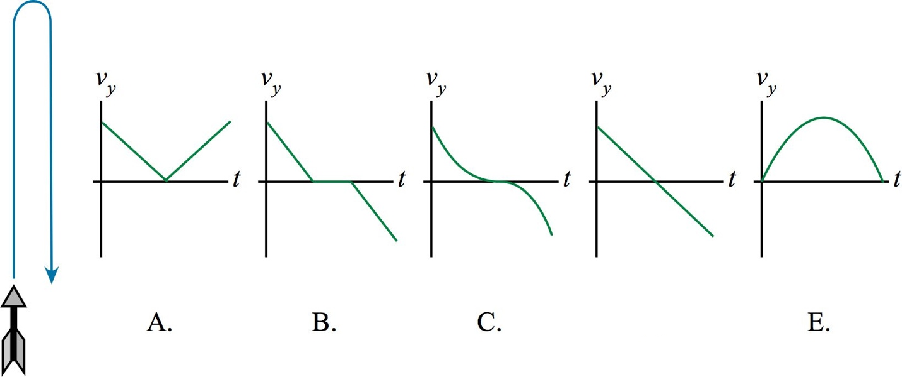
Answer
An arrow is launched vertically upward. It moves straight up to a maximum height, then falls to the ground. The trajectory of the arrow is noted. Which graph best represents the vertical velocity of the arrow as a function of time? Ignore air resistance; the only force acting is gravity.
D.
Slide 2-40
Notes:
Answer: D

Slide 58
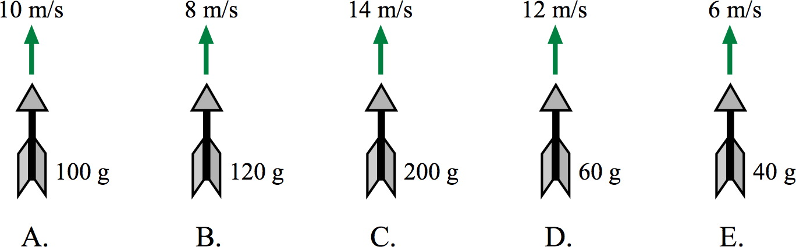
Checking Understanding
The figure below shows five arrows with differing masses that were launched straight up with the noted speeds. Rank the arrows, from greatest to least, on the basis of the maximum height the arrows reach. Ignore air resistance; the only force acting is gravity.
E > D > A > B > C
C > D > A > B > E
C > B > A > D > E
E > B > A > D > C
Slide 2-41
Notes:
Answer: B

Slide 59
Answer
The figure below shows five arrows with differing masses that were launched straight up with the noted speeds. Rank the arrows, from greatest to least, on the basis of the maximum height the arrows reach. Ignore air resistance; the only force acting is gravity.
E > D > A > B > C
C > D > A > B > E
C > B > A > D > E
E > B > A > D > C
Slide 2-42
Notes:
Answer: B

Slide 60
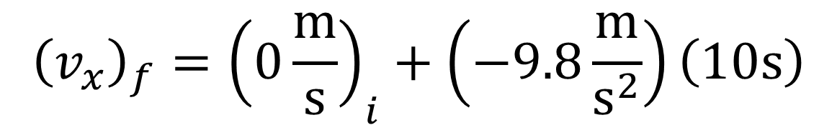

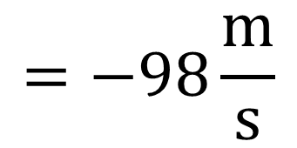
Motion with constant acceleration
Position independent
$${\left(v_{x}\right)}_{f}={\left(v_{x}\right)}_{i}+a_{x}∆t$$
What is a skydiver’s falling speed 10 seconds after he jumps if air drag is ignored?
$${\left(v_{x}\right)}_{f}={\left(0\frac{\text{m}}{\text{s}}\right)}_{i}+\left(−9.8\frac{\text{m}}{{\text{s}}^{2}}\right)\left(10\text{s}\right)$$
$$=−98\frac{\text{m}}{\text{s}}$$
How many miles an hour is this?

Slide 61
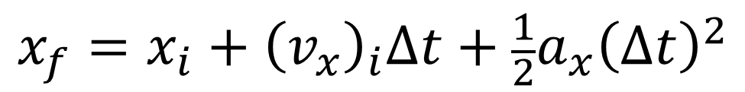

Motion with constant acceleration
Final velocity independent
$$x_{f}=x_{i}+{\left(v_{x}\right)}_{i}∆t+\frac{1}{2}a_{x}{\left(∆t\right)}^{2}$$
Where is a skydiver 10 seconds after he falls from 5990m?
$$x_{f}=5990\text{m}+\left(0\frac{\text{m}}{\text{s}}\right)\left(10\text{s}\right)+\frac{1}{2}\left(−9.8\frac{\text{m}}{{\text{s}}^{2}}\right){\left(10\text{s}\right)}^{2}$$
$$x_{f}=5990\text{m}−490\text{m}$$
Did he hit the ground already?... Not even close
$$x_{\text{f}}≅5500\text{m}$$

Slide 62

Motion with constant acceleration
time independent
$${{\left(v_{x}\right)}_{\text{f}}}^{2}={{\left(v_{x}\right)}_{\text{i}}}^{2}+{2a}_{x}∆x$$
Find the skydiver’s final velocity with out knowing how long he fell but rather how far….

Slide 63


Choosing the right Equation
Spud Webb, height 5'7", was one of the shortest basketball players to play in the NBA. But he had an impressive vertical leap; he was reputedly able to jump 110 cm off the ground. To jump this high, with what speed would he leave the ground?
A football is punted straight up into the air; it hits the ground 5.2 s later. With what speed did it leave the kicker’s foot?
What was the greatest height reached by the ball?
$${{\left(v_{y}\right)}_{\text{f}}}^{2}={{\left(v_{y}\right)}_{\text{i}}}^{2}+{2a}_{y}∆y$$
$${\left(v_{y}\right)}_{f}={\left(v_{y}\right)}_{i}+a_{x}∆t→v_{yi}=9.8\frac{\text{m}}{{\text{s}}^{2}}∙2.6\text{s}$$
Then:
$$y_{f}=y_{i}+{\left(v_{y}\right)}_{i}∆t+\frac{1}{2}a_{y}{\left(∆t\right)}^{2}$$
$$y_{f}=25.48\frac{\text{m}}{\text{s}}∙2.6\text{s}+\frac{1}{2}∙9.8\frac{\text{m}}{{\text{s}}^{2}}∙{\left(2.6\right)}^{2}$$
Slide 2-43

Slide 64




Example Problem
Tennis balls are tested by measuring their bounce when dropped from a height of approximately 2.5 m. What is the final speed of a ball dropped from this height?
$${v_{f}}^{2}={{\left(v\right)}_{\text{i}}}^{2}+2a∆y$$
$$v_{f}=\sqrt{{{\left(0\frac{\text{m}}{\text{s}}\right)}_{\text{i}}}^{2}+2∙\left(−9.81\frac{\text{m}}{{\text{s}}^{2}}\right)∙\left(−2.5\text{m} \right)}$$
$$v_{f}≅\sqrt{50}\frac{\text{m}}{\text{s}}$$
Slide 2-34

Slide 65



What equation do I use?
Passengers on The Giant Drop, a free-fall ride at Six Flags Great America, sit in cars that are raised to the top of a tower. The cars are then released for 2.6 s of free fall. How fast are the passengers moving at the end of this speeding up phase of the ride?
If the cars in which they ride then come to rest in a time of 1.0 s, what is the acceleration (magnitude and direction) of this slowing down phase of the ride?
Given these numbers, what is the minimum possible height of the tower?
$${\left(v_{y}\right)}_{f}={\left(v_{y}\right)}_{i}+a_{y}∆t$$
$${\left(v_{y}\right)}_{f}={\left(v_{y}\right)}_{i}+a_{y}∆t$$
Use this equation twice to find the displacement each phase and then add them
$$y_{f}=y_{i}+{\left(v_{y}\right)}_{i}∆t+\frac{1}{2}a_{y}{\left(∆t\right)}^{2}$$
Slide 2-44

Slide 66



Example Problems
A polevaulter is nearly motionless as he clears the bar, set 5.2 m above the ground. He then falls onto a thick pad. The top of the pad is 75 cm above the ground; it compresses by 50 cm as he comes to rest. What is his acceleration as he comes to rest on the pad?
This problem has 2 phases
Phase 1, find his velocity just before he hits the pad with:
Phase 2, find how quickly he slowed down as the pad compressed with:
$${v_{f}}^{2}={v_{i}}^{2}+2a∆y$$
$${v_{f}}^{2}={v_{i}}^{2}+2a∆y$$
Slide 2-44

Slide 67


Example Problems
A polevaulter is nearly motionless as he clears the bar, set 5.2 m above the ground. He then falls onto a thick pad. The top of the pad is 75 cm above the ground; it compresses by 50 cm as he comes to rest. What is his acceleration as he comes to rest on the pad?
Now plug in values:
Phase 1
Phase 2, use the above velocity for the initial velocity here and this time the displacement is “how much the pad was compressed”, then solve for the acceleration.
$$v_{f}=\sqrt{{{\left(0\right)}_{\text{i}}}^{2}+2a∆y }→\sqrt{2\left(−9.8\frac{\text{m}}{{\text{s}}^{2}}\right)\left(.75\text{m}−5.2\text{m}\right)}$$
$$v_{f}=9.339\frac{\text{m}}{\text{s}}$$
$${v_{f}}^{2}=v_{i}^{2}+2a∆y$$
Slide 2-44

Slide 68

Summary
Slide 2-45

Slide 69

Summary
Slide 2-46

Slide 70
Example Problems
A train is approaching a town at a constant speed of 12 m/s. The town is 1.0 km distant. After 30 seconds, the conductor applies the breaks. What acceleration is necessary to bring the train to rest exactly at the edge of town?
Slide 2-35

Slide 71




Example Problems
A train is approaching a town at a constant speed of 12 m/s. The town is 1.0 km distant.
After 30 seconds, the conductor applies the breaks. What acceleration is necessary to bring the train to rest exactly at the edge of town?
First find how far he traveled before he began to slow down
$$d=vt=12\frac{\text{m}}{\text{s}}∙30\text{s}\text{ = 360}\text{m}$$
Then find his acceleration with:
$$v_{f}^{2}=v_{i}^{2}+2a∆x$$
$$12\frac{\text{m}}{\text{s}}$$
$$1.0\text{km}$$
Slide 2-35

Slide 72



Example Problems
A train is approaching a town at a constant speed of 12 m/s. The town is 1.0 km distant. After 30 seconds, the conductor applies the breaks. What acceleration is necessary to bring the train to rest exactly at the edge of town?
$$d\text{= 360}\text{m}$$
$${\left(0\frac{\text{m}}{\text{s}}\right)}^{2}={\left(12\frac{\text{m}}{\text{s}}\right)}^{2}+2a\left(1000\text{m}−360\text{m}\right)$$
Solve for $a$
$$12\frac{\text{m}}{\text{s}}$$
$$1.0\text{km}$$
Slide 2-35

Slide 73

Additional Questions
A particle moves with the position-versus-time graph shown. Which graph best illustrates the velocity of the particle as a function of time?
A.
B.
C.
D.
Slide 2-47
Notes:
Answer: A

Slide 74
Answer
A particle moves with the position-versus-time graph shown. Which graph best illustrates the velocity of the particle as a function of time?
A.
B.
C.
D.
Slide 2-48
Notes:
Answer: A

Slide 75

Additional Questions
Masses P and Q move with the position graphs shown. Do P and Q ever have the same velocity? If so, at what time or times?
P and Q have the same velocity at 2 s.
P and Q have the same velocity at 1 s and 3 s.
P and Q have the same velocity at 1 s, 2 s, and 3 s.
P and Q never have the same velocity.
Slide 2-49
Notes:
Answer: A

Slide 76
Answer
Masses P and Q move with the position graphs shown. Do P and Q ever have the same velocity? If so, at what time or times?
P and Q have the same velocity at 2 s.
P and Q have the same velocity at 1 s and 3 s.
P and Q have the same velocity at 1 s, 2 s, and 3 s.
P and Q never have the same velocity.
Slide 2-50
Notes:
Answer: A

Slide 77
Masses P and Q move with the position graphs shown. Do P and Q ever have the same position? If so, at what time or times?
P and Q have the same position at 2 s.
P and Q have the same position at 1 s and 3 s.
P and Q have the same position at 1 s, 2 s, and 3 s.
P and Q never have the same position.

Slide 78

Additional Questions
Mike jumps out of a tree and lands on a trampoline. The trampoline sags 2 feet before launching Mike back into the air. At the very bottom, where the sag is the greatest, Mike’s acceleration is:
Upward
Downward
Zero
Slide 2-51
Notes:
Answer: A

Slide 79
Answer
Mike jumps out of a tree and lands on a trampoline. The trampoline sags 2 feet before launching Mike back into the air. At the very bottom, where the sag is the greatest, Mike’s acceleration is:
Upward
Downward
Zero
Slide 2-52
Notes:
Answer: A

Slide 80





Additional Example Problems
When you stop a car on a very slick icy pavement, the acceleration of your car is approximately –1.0 m/s². If you are driving on icy pavement at 30 m/s (about 65 mph) and hit your brakes, how much distance will your car travel before coming to rest?
$$a=−1.0\frac{\text{m}}{{\text{s}}^{2}}$$
$$v_{i}=30\frac{\text{m}}{\text{s}}$$
$$v_{f}=0\frac{\text{m}}{\text{s}}$$
Solve for $∆x$ with:
$$v_{f}^{2}=v_{i}^{2}+2a∆x$$
Slide 2-53

Slide 81



Additional Example Problems
As we will see in a future chapter, the time for a car to come to rest in a collision is always about 0.1 s. Ideally, the front of the car will crumple as this happens, with the passenger compartment staying intact. If a car is moving at 15 m/s and hits a fixed obstacle, coming to rest in 0.10 s, what is the acceleration?
How much does the front of the car crumple during the collision?
$${\left(v_{x}\right)}_{f}={\left(v_{x}\right)}_{i}+a_{x}∆t$$
Solve for $∆x$ with:
$$v_{f}^{2}=v_{i}^{2}+2a∆x$$
Slide 2-53

Slide 82
MCAT style question
If an astronaut can jump straightup to a height of .5m on earth, how high could he jump on the moon?
1.2 m
3.0 m
3.6 m
18 m

Slide 83
MCAT style question
On the earth, an astronaut can safely jump to the ground from a height of 1.0 m; her velocity when reaching the ground is slow enough to not cause injuries. From what height could the astronaut safely jump to the ground on the moon?
2.4 m
6.0 m
7.2 m
36 m

Slide 84
MCAT style question
On the earth, an astronaut throws a ball straight upward; it stays in the air for a total time of 3.0 s before reaching the ground again. If a ball were to be thrown upward with the same initial speed on the moon, how much time would pass before it hit the ground?
7.3 s
18 s
44 s
108 s

